Slide 1
Establishing Consistent Radiometric Calibration between NOAA AVHRR and Suomi NPP VIIRS to Improve Satellite Data Quality for Weather and Climate
Sirish Uprety
CIRA, Colorado State University
Changyong Caoª, Slawomir Blonski^{b} and Xi Shao^{b}
ªNOAA/NESDIS/STAR, ^{b}University of Maryland

Slide 2
Outline
Objective
Background
S-NPP VIIRS on-orbit radiometric performance
SNO-x over N. African deserts
Using MODIS as a reference
VIIRS and NOAA-19 AVHRR (0.64 µm and 0.86 µm) inter-comparison
SNO/SNO-x
Vicarious Calibration site (Antarctica Dome C)
Results and Analysis
Summary and Future work

Slide 3
Objective
Assess the radiometric performance of VIIRS
Using VIIRS as a reference sensor, assess the radiometric consistency between S-NPP VIIRS and NOAA-19 AVHRR for VNIR bands

Slide 4
Background
Satellite sensor degradation over time is a common phenomenon.
Temporal radiometric drift should be correctly characterized.
Post-launch Sensor calibration/validation:
Onboard calibrators.
Vicarious sites such as desert, ocean, snow etc.
Exo-terrestrial targets such as moon, stars etc.
Inter-calibration with other instruments (SNO/SNO-x, desert targets etc).
NOAA series AVHRR instruments lacks OBC system.
AVHRR relies on desert (21°-23°N, 28°-29°E) for on-orbit calibration.
Study is basically a two-step process:
1. VIIRS calibration accuracy is estimated using inter-calibration with MODIS.
2. Radiometric consistency of AVHRR estimated using VIIRS through inter-comparison.
Use NOAA-19 AVHRR to cross-calibrate other AVHRR instruments back in time to tie multi-decadal data into same radiometric scale.

Slide 5
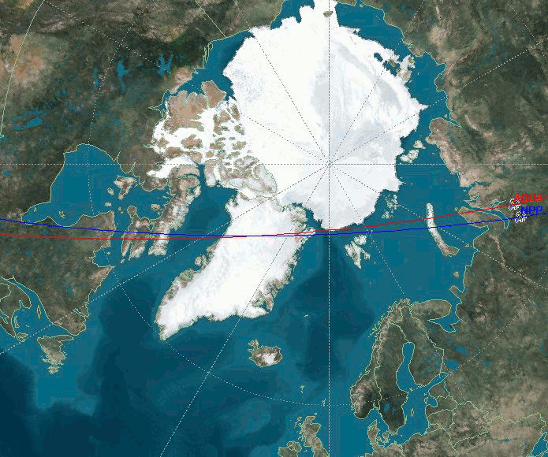
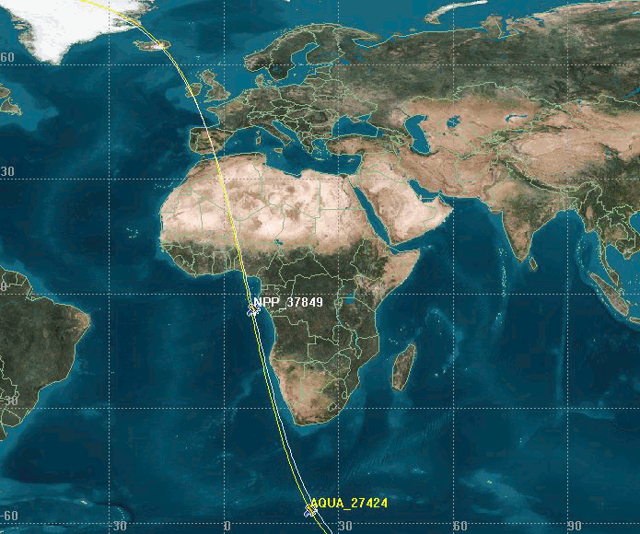
SNO and SNO-x
Simultaneous nadir overpass (SNO): Comparison of simultaneous measurements between two or more instruments at their orbital intersection with nearly identical viewing conditions.
SNOs usually occur at high-latitude polar region for polar orbiting satellites.
However, there exists SNO events between Suomi NPP and NOAA-19 at low latitudes, but with larger time differences of more than 10 minutes.
SNO-x in low latitudes is an approach inherited from traditional SNO approach that extends SNO orbits to low latitudes for inter-comparing sensors over a wide dynamic range such as over ocean surface, desert targets, green vegetation etc.
In this study, VIIRS and AVHRR sensors are compared at overlapping regions of extended SNO orbits at North African deserts.
SNO
SNO
Source: STK

Slide 6
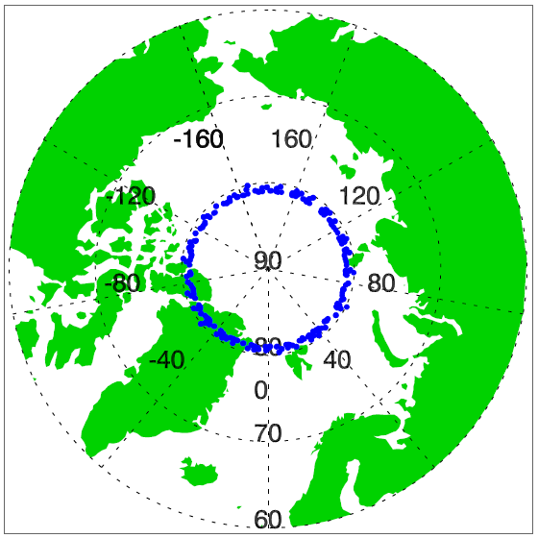
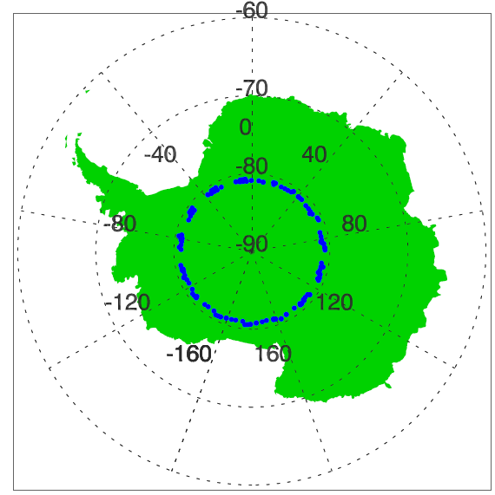
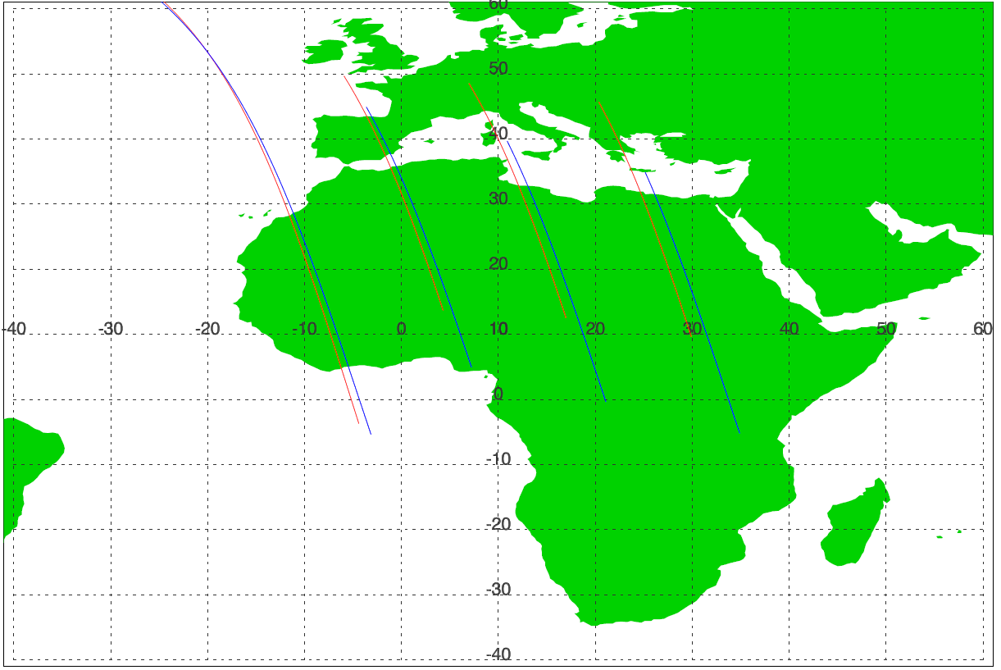
Methodology
SNO (N-19 and S-NPP)
SNO (VIIRS and AVHRR)
For each SNO event, download VIIRS and N-19 AVHRR GAC data
Extract ROI (20km * 20km) of VIIRS and AVHRR with center @ orbital intersection
Calculate mean of all pixels within ROI
Bias= (VIIRS-AVHRR)*100%/VIIRS
Repeat above steps for all SNO events and extract bias time series
SNO-x (VIIRS and AVHRR)
For each SNO-x event, download VIIRS and N-19 AVHRR GAC data
Find overlapping region in the desert
Extract multiple collocated ROIs (20km * 20km) of VIIRS and AVHRR
Calculate mean of all pixels within each ROI
Bias= (VIIRS-AVHRR)*100%/VIIRS
Calculate mean and stdev of all biases for each SNO-x event
Extract bias time series and analyze AVHRR rad. performance
NH
SH
SNO-x
SNO
Note: Time Difference for SNO: <90 seconds and SNO-x: <20 mins.

Slide 7
Methodology contd.
Vicarious Sites: TOA Ref. time series
EO-1 Hyperion: Hyperspectral analysis
Collect L1B Data of
VIIRS and N-19 AVHRR over
http://www.nsof.class.noaa.gov/
Collect L1Gst Data
http://glovis.usgs.gov/
Extract Reflectance Dome C
Extract TOA Reflectance
Extract ROI (3km * 3km), calculate Mean and Stdev of all pixels within ROI for all channels
Extract ROI (30*30 km) and calculate Mean and Stdev of pixels within ROI
Extract reflectance mean as a function of wavelength and analyze spectral characteristics and Bias
Derive reflectance time series and estimate bias

Slide 8
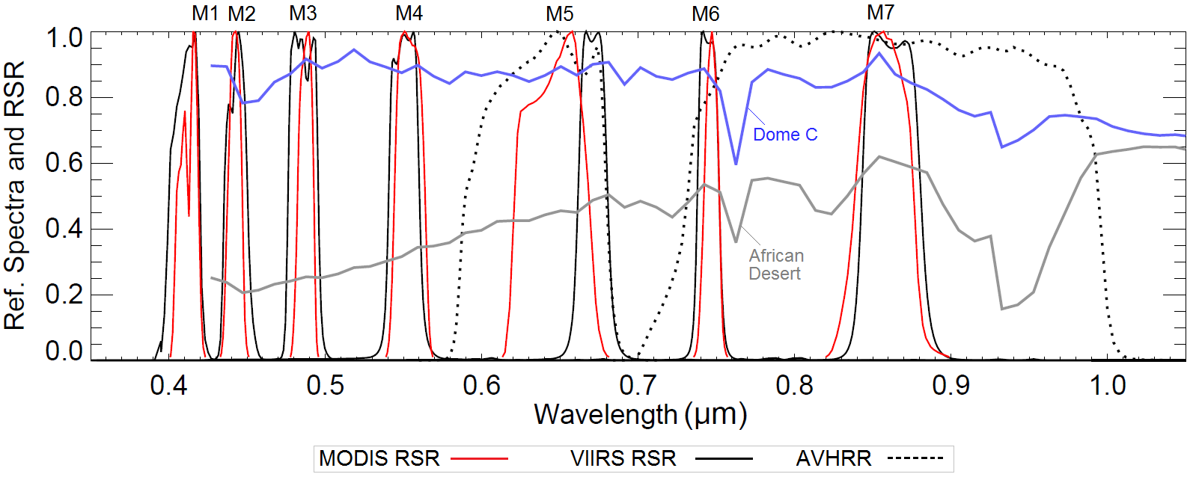
VIIRS, MODIS and AVHRR Matching Bands
VIIRS |  | MODIS |  | AVHRR
Band | Wavelength (µm) | Band | Wavelength (µm) | Band | Wavelength (µm)
M1 | 0.402 - 0.422 | 8 | 0.405 - 0.420 | - | -
M2 | 0.436 - 0.454 | 9 | 0.438 - 0.448
M3 | 0.478 - 0.498 | 10 | 0.483 - 0.493
M4 | 0.545 - 0.565 | 4 | 0.545 - 0.565
M5 | 0.662 - 0.682 | 1 | 0.620 - 0.670 | 1 | 0.58 – 0.68
 |  | 13 | 0.662 - 0.672
M6 | 0.739 - 0.754 | 15 | 0.743 - 0.753 | - | -
M7 | 0.846 - 0.885 | 2 | 0.841 - 0.876 | 2 | 0.725 – 1.0
 |  | 16 | 0.862 - 0.877
M8 | 1.230 - 1.250 | 5 | 1.230 - 1.250 | - | -

Slide 9
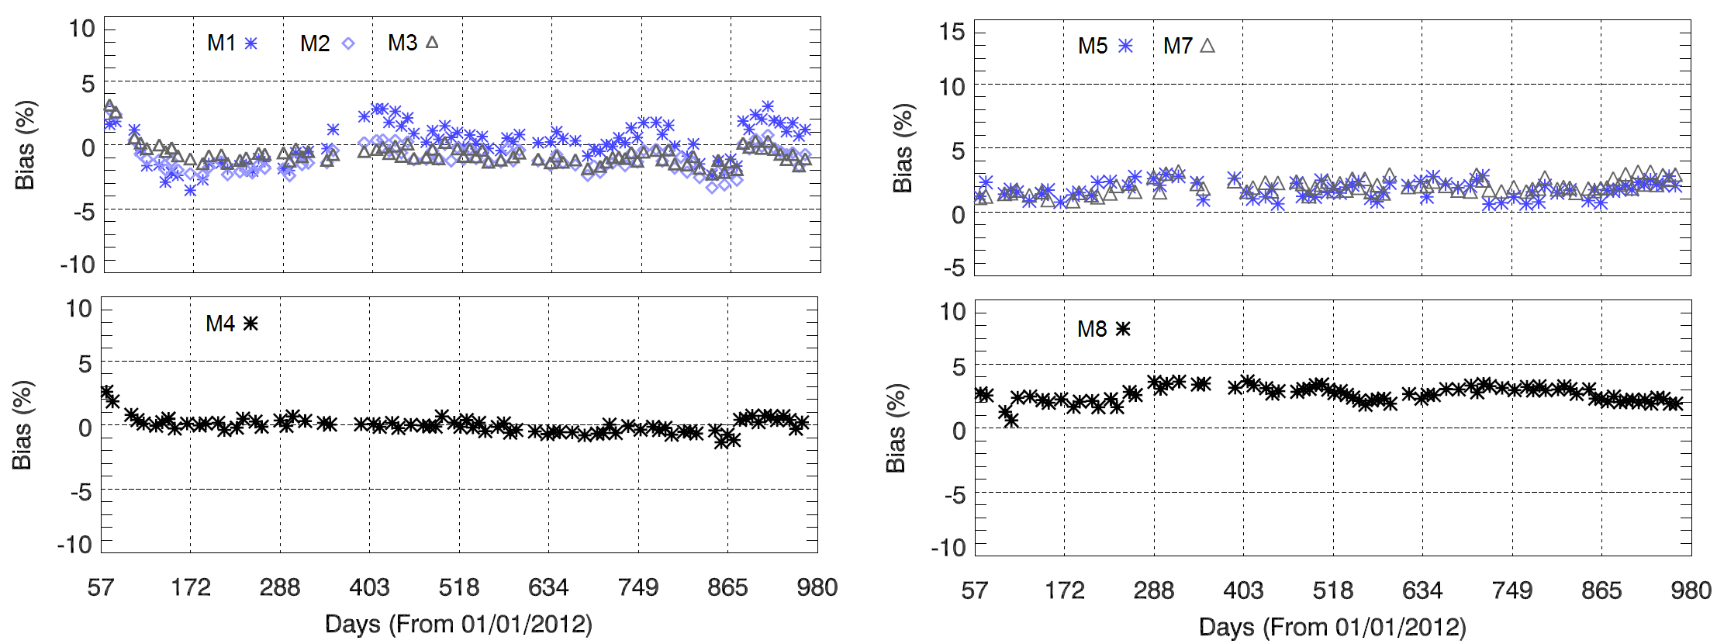
VIIRS Bias over Desert (SNO-x)
4
1
2
3
SNO-x based inter-comparison of S-NPP VIIRS and AQUA MODIS
VIIRS bias for M bands (M1 to M8) relative to MODIS using SNO-x is within 2% ± 1%.
M10 bias estimated using Libya-4 and Sudan-1deserts is on the order of 2.0% ± 0.4%
M11 RSR doesn’t match with MODIS and indicates large observed bias ~6% ± 1% before accounting spectral differences.

Slide 10
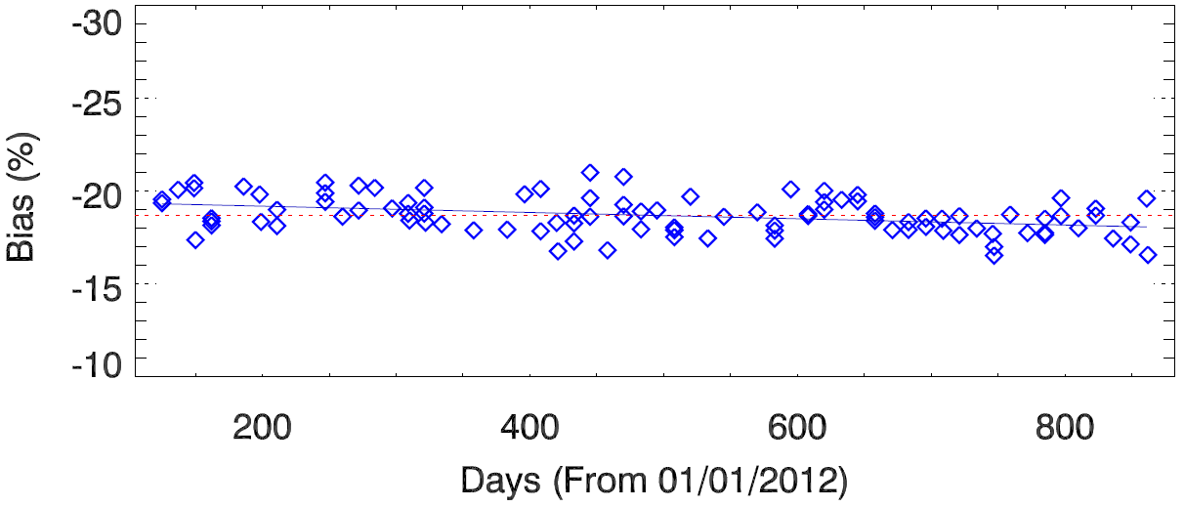
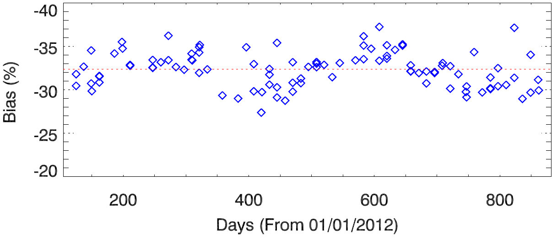
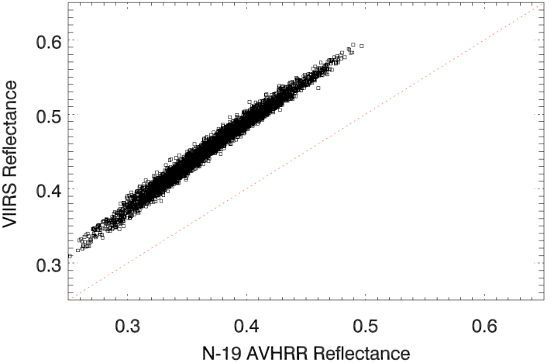
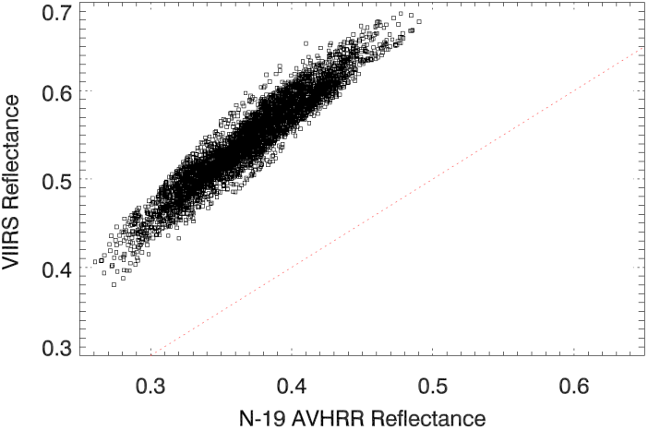
AVHRR Bias over Desert (SNO-x)
AVHRR Band1 (0.64 µm) and VIIRS Band M-5
AVHRR Band 2 (0.86 µm) and VIIRS Band M-7
Bias (%): -19.46 + 0.00165 * Days Bias change: -1.21%
Bias: -32.2% ± 2.12%
Figure indicates AVHRR B1 degradation by about 1.2% over the period of 2 years.
Note: AVHRR data used is post-launch calibrated data using Libyan desert

Slide 11
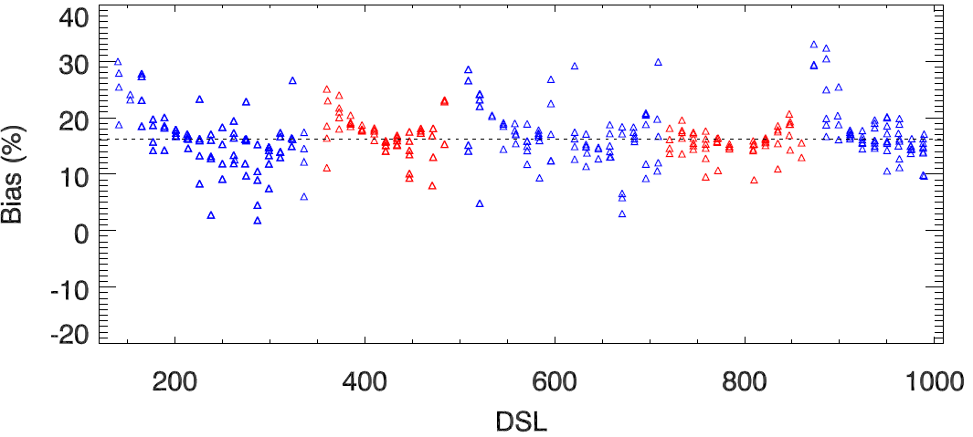
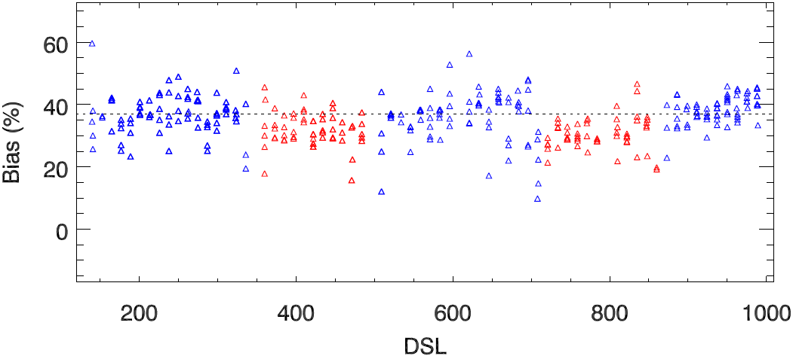
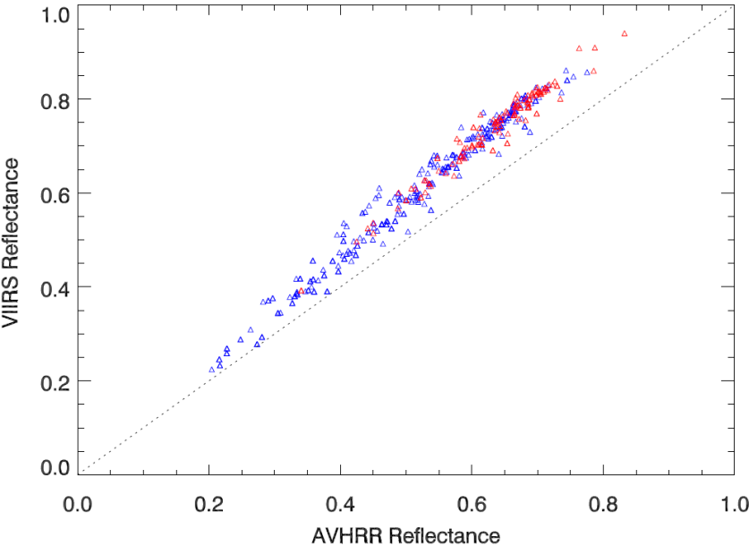
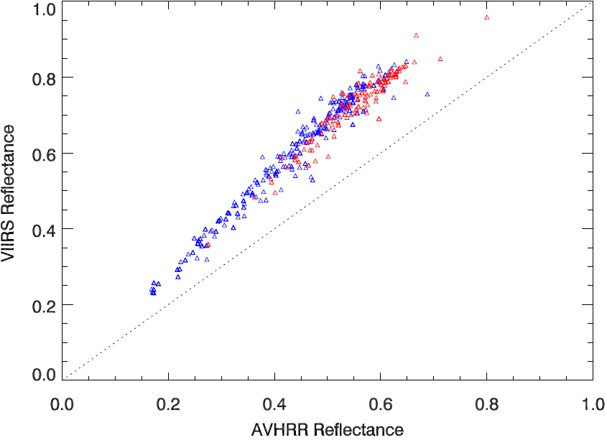
AVHRR Bias over Polar Region (SNO)
AVHRR Band1 (0.64 µm) and VIIRS Band M-5
AVHRR Band 2 (0.86 µm) and VIIRS Band M-7
15.99% +/- 5.79%
35.38% +/- 6.58%
Larger variability in NH for AVHRR B1 due to target variability compared to mostly snow over SH.
AVHRR B2 bias indicates large water vapor absorption variability.
Bias is mainly due to calibration uncertainty, spectral differences, and atmospheric variability.
Robust filtering algorithm needed and will be investigated in future

Slide 12
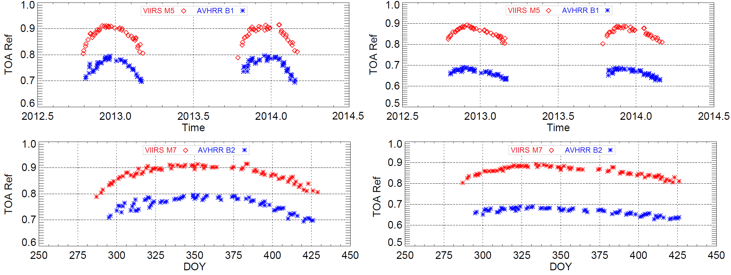
AVHRR and VIIRS over Dome C
Large variability
DOY= DOY (Jan-Mar) + 365 or 366
Note: AVHRR B1 suggest larger scatter during Oct-Dec mainly due to ozone absorption variability at nearly 0.6 µm.
AVHRR (µm) | VIIRS (µm) | AVHRR Observed Bias (DOY = 340)
B1 (0.58 – 0.68) | M5 (0.662 - 0.682) | -13.05% ± 0.83%
B1 (0.725 – 1.0) | M7 (0.846 - 0.885) | -22.5% ± 0.71%

Slide 13
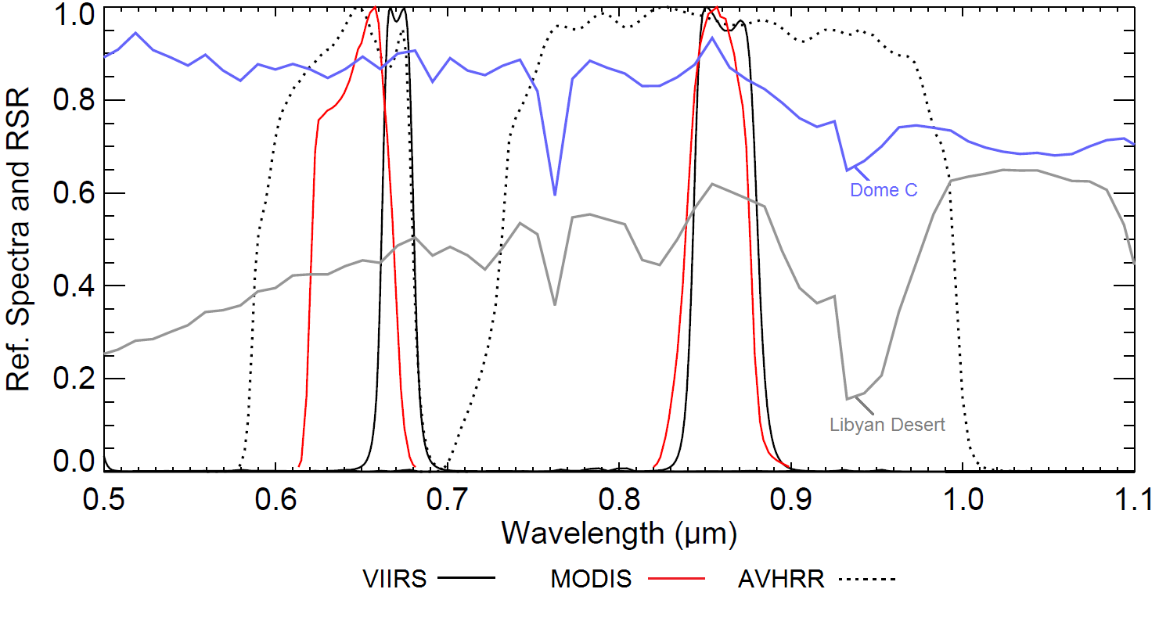
Expected Spectral Bias
Expected Spectral Bias (ESB) exists due to differences in RSR shape and spectral coverage between AVHRR and VIIRS bands.
simulated reflectance for VIIRS and AVHRR is estimated by convolving hyperspectral measurements of North African desert with instrument RSRs
ESB = where,
AVHRR
B1
AVHRR
B2
AVHRR
B2
AVHRR | VIIRS | AVHRR Spectral Bias, (A-V)*100%/V
 |  | Libyan Desert | Dome C
B1 (0.64 um) | M5 | -9.60% ± 0.17% | -3.65% ± 0.4%
B2 (0.86 um) | M7 | -18.91% ± 0.92% | -7.9% ± 0.7%

Slide 14
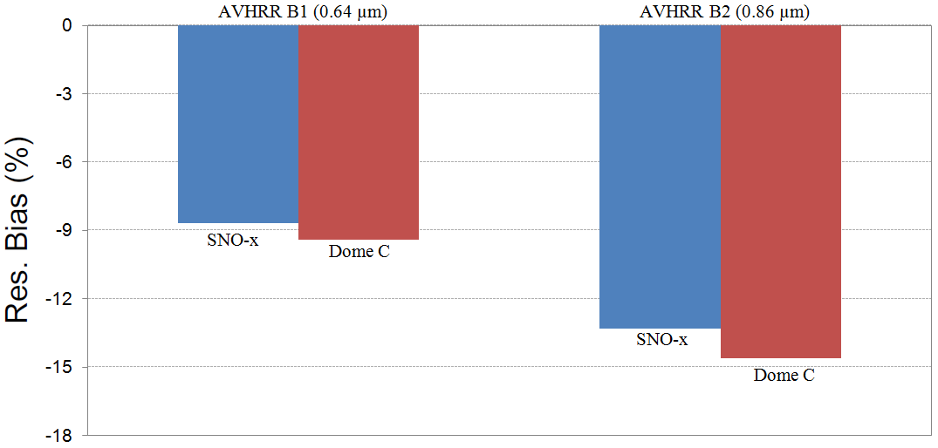
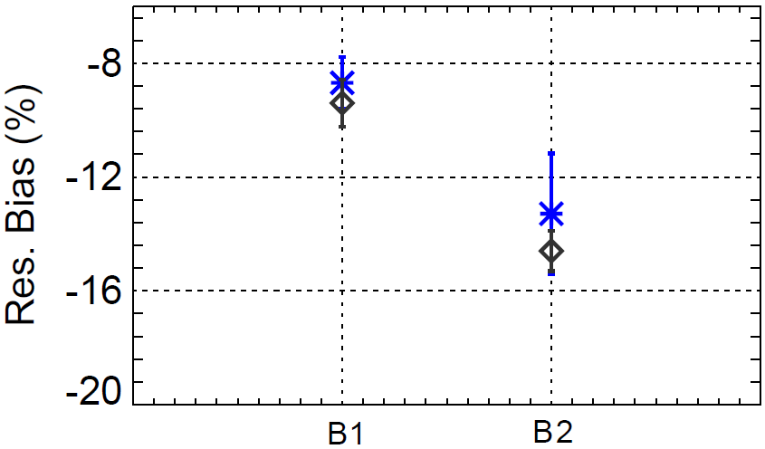
Residual Bias of AVHRR
The differences in spectral response functions of instruments is one of the contributing factors for large bias.
If the spectral characteristics of the sites are well characterized, the impact of spectral differences in inter-comparison can be accounted.
Residual Bias: Observed Bias (measurements) – ESB (spectral differences)
Residual bias over desert should agree with Dome C irrespective of the spectral differences.
AVHRR |  | VIIRS |  | Residual Bias
Band | Wavelength (µm) | Band | Wavelength (µm) | African Desert (SNO-x) | Dome C
1 | 0.58 – 0.68 | M-5 | 0.662 - 0.682 | -8.70% ± 0.91% | -9.4 ± 0.83%
2 | 0.725 – 1.0 | M-7 | 0.846 - 0.885 | -13.30 ± 2.12% | -14.6 ± 0.71%

Slide 15
Summary and Future Work
SNO-x inter-comparison indicates relative degradation of AVHRR band 1 (0.64 µm) by 1.2% over the period of two years.
SNO-x suggests that AVHRR bias relative to VIIRS is -8.7% ± 0.9% for band 1 (0.64 µm) and -13.3% ± 2.1% for band 2 (0.86 µm).
Larger bias for AVHRR B1 is believed to be due to calibration uncertainties. However, the large bias and large uncertainty for AVHRR band 2 is primarily due to the presence of water vapor absorption wavelength in its SRF.
Radiometric bias estimated over Antarctica Dome C site agrees well with SNO-x to within 1% for AVHRR B1 and B2.
SNO inter-comparison over high latitude polar region indicates stable trends but with larger variability of more than 5% both for AVHRR B1 and B2.
Large variability in SNO time series is mainly due to comparison over different target types in NH (such as snow, ocean, vegetation) and change in solar geometry during summer and winter solstice.
The approach can be used to connect other AVHRR sensors back in time into same radiometric scale.

Slide 16
References
Uprety, Sirish, Changyong Cao, Xiaoxiong Xiong, Slawomir Blonski, Aisheng Wu, Xi Shao 2013. “Radiometric Inter-comparison between Suomi NPP VIIRS and Aqua MODIS Reflective Solar Bands using Simultaneous Nadir Overpass in the Low Latitudes”. Journal of Atmospheric and Oceanic Technology, 30, pp:2720–2736.
Cao Changyong, Frank DeLuccia, Xiaoxiong Xiong, Robert Wolfe, Fuzhong Weng (2013). “Early On-orbit Performance of the Visible Infrared 1 Imaging Radiometer Suite (VIIRS) onboard the Suomi National Polar-orbiting Partnership (S3 NPP) Satellite”, IEEE Transaction on Geoscience and Remote Sensing, Volume: 52, Issue: 2, pp: 1142 - 1156.
Cao, Changyong, J. Xiong, S. Blonski, Q. Liu, S. Uprety, X. Shao, Y. Bai, F. Weng, 2013. "Suomi NPP VIIRS sensor data record verification, validation, and long‐term performance monitoring". Journal of Geophysical Research: Atmospheres, 118 (20), 11,664-11,678.
Cao, Changyong, Sirish Uprety, Jack Xiong, Aisheng Wu, Ping Jing, David Smith, Gyanesh Chander, Nigel Fox, and Stephen Ungar, 2010. "Establishing the Antarctic Dome C Community Reference Standard Site towards consistent Measurements from Earth Observation Satellites". Canadian Journal of Remote Sensing, 36:(5) , pp: 498-513.
Uprety, Sirish, and Changyong Cao, 2012. “Radiometric and spectral characterization and comparison of the Antarctic Dome C and Sonoran Desert sites for the calibration and validation of visible and near-infrared radiometers”. J. Appl. Remote Sens. 6(1), 063541.
Sirish Uprety, Changyong Cao, Slawomir Blonski, Xi Shao, 2013. "Evaluating radiometric consistency between Suomi NPP VIIRS and NOAA-19 AVHRR using extended simultaneous nadir overpass in the low latitudes". Proc. of SPIE Vol. 8866.
Cao, C., M. Weinreb, and H. Xu, 2004. “Predicting Simultaneous Nadir Overpasses among Polar-Orbiting Meteorological Satellites for the Intersatellite Calibration of Radiometers”. J. Atmos. Oceanic Technol., 21, 537–542.

